Slide 1
Interactive Studio ECE 532
Farshad Safavi Shaoyu Chen Shadi Dashmiz Harry Wang

Slide 2
What Is The Project?
Designing a system capable of replicating the Chroma keying effect with the addition of an associated interactive element including:
Replacing a blue screen with a desired image.
Motion tracking of an object in front of the blue screen.
Interactive animations between the object’s motion and the background image.

Slide 3
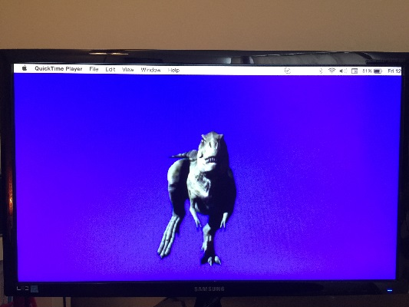
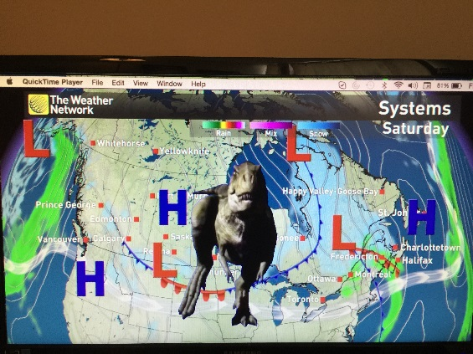
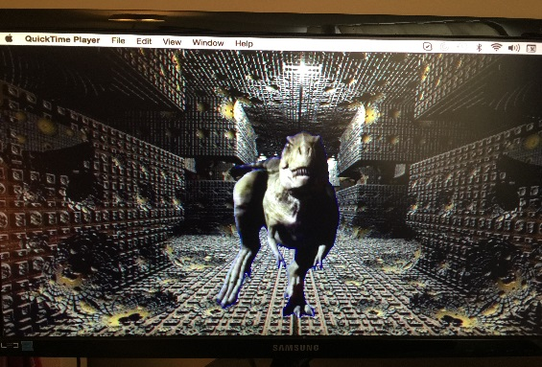
What We Ended Up With
We achieved initial goals!
We are able to replace any range of blue color with our desired image. Range of blue color is controlled by a register from the software.
Pictures illustrate color replacement

Slide 4
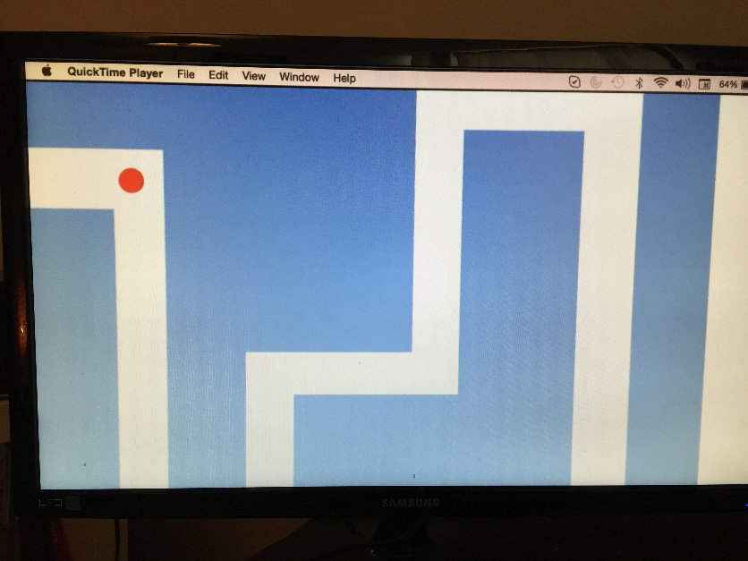
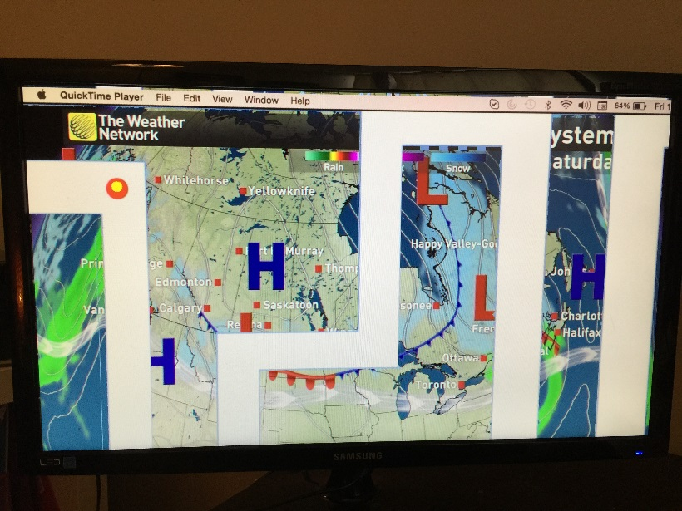
What We Ended Up With
We are able to detect a red color object.
We can interact with the background image using a simple animation

Slide 5
Block Diagram of Final System
AXI4-Stream AXI-Lite

Slide 6
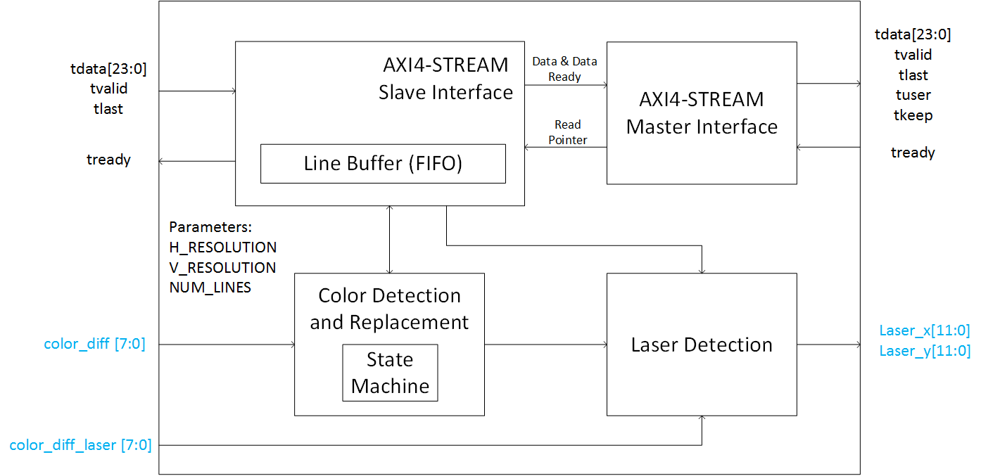
Replacement IP

Slide 7
Laser Detection IP

Slide 8
Managing Our Team Members
Store Image, Read and write VDMA
Develop AXI Steam IP
RTL design color replacement
Develop Laser Detection IP
Shadi
Harry
Shaoyu
Debug Laser Detection and system optimization
Debug Color Replacement Software
Develop Animation
Farshad
system level integration and Software optimization
Develop Laser Detection IP and Prototyping in software
Develop Animation
Debug and verification of Color Replacement Hardware
RTL design of color replacement

Slide 9
Problems We Encountered
The main problem was optimization to speedup the system.
The video streaming was very slow in the beginning. We had to optimize both software and hardware many iterations to speedup the design.
2. Complex animations will slow down the whole system,
had to stay with simpler animations

Slide 10
What We Learnt
System level design
how to interconnect software and hardware
How to develop IPs
How to do system level simulations and verifications
Learn about FPGA applications of image processing
Understanding specifications before implementation

Slide 11
Thank You!

